Slide 1

References
Chris Piech
CS106A, Stanford University

Slide 2

Learning Goals
Be able to write a large program
Be able to trace memory with references

Slide 3
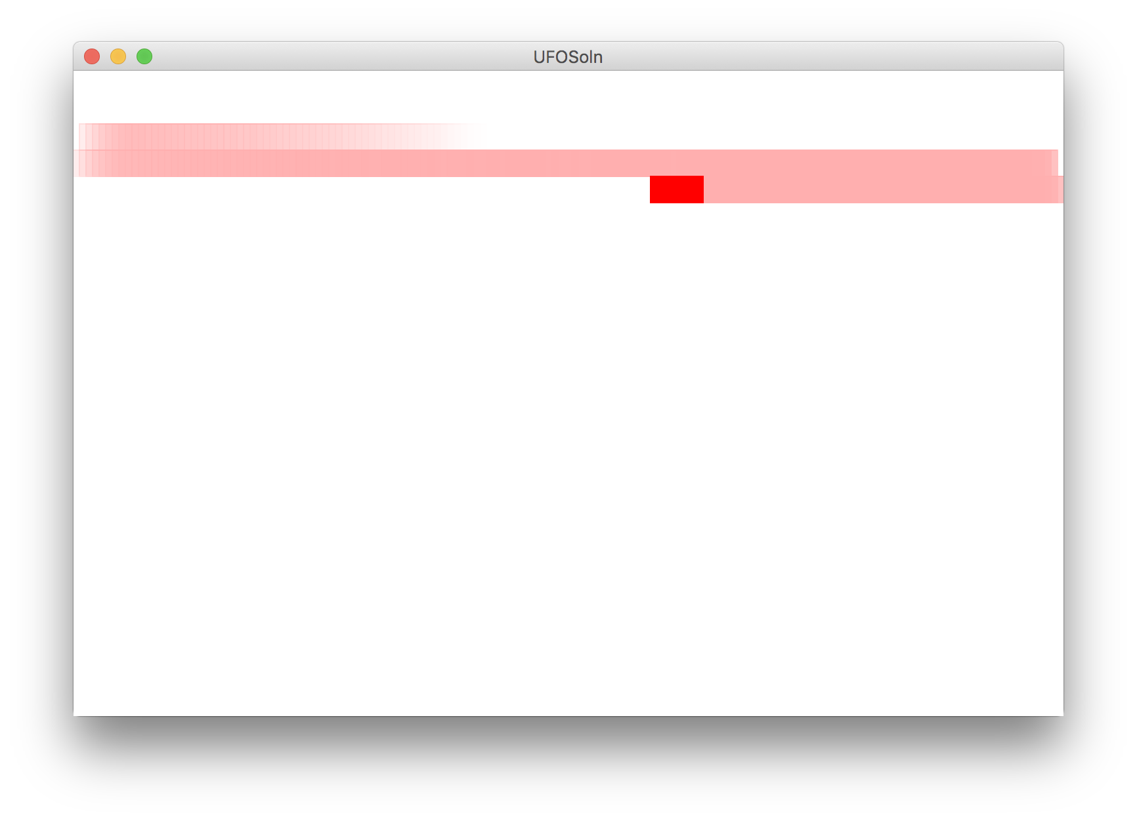
Today, we build!

Slide 4
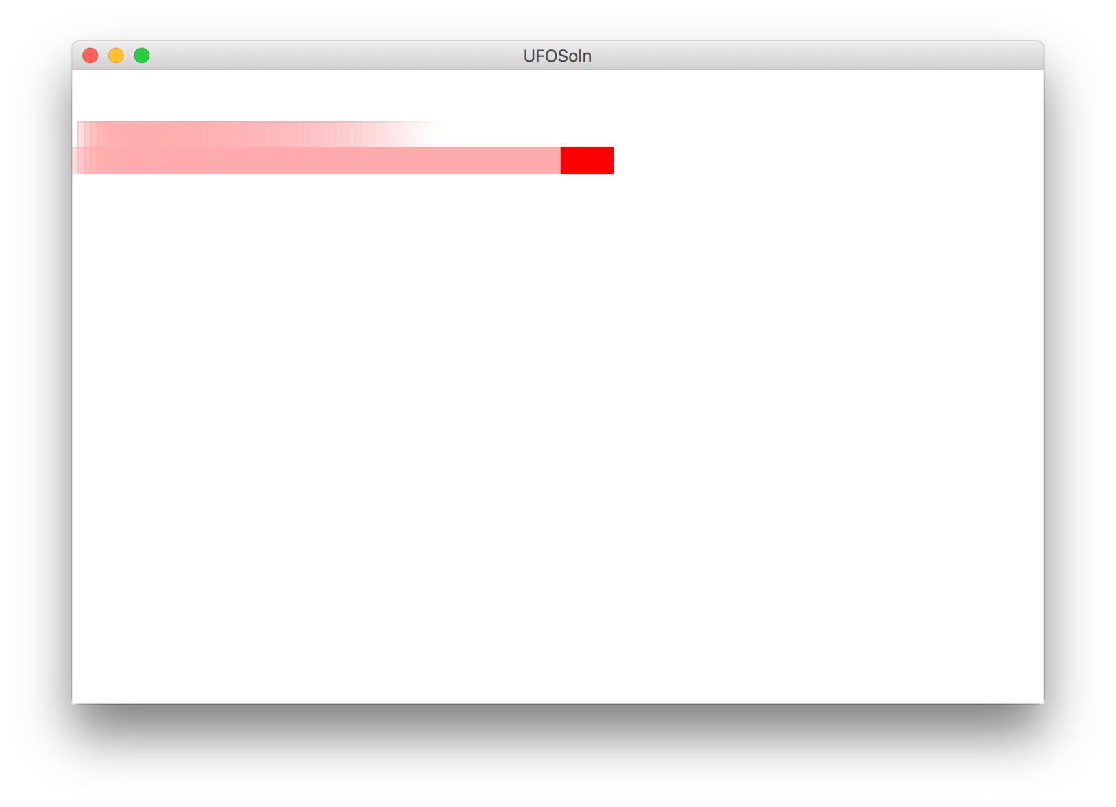
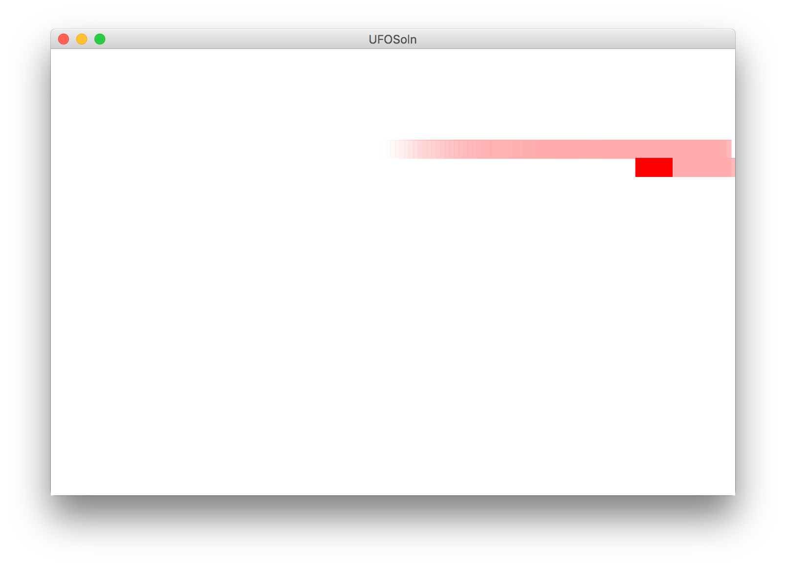
Milestones
Milestone 1
Milestone 2

Slide 5
Advanced memory model

Slide 6
Core memory model

Slide 7
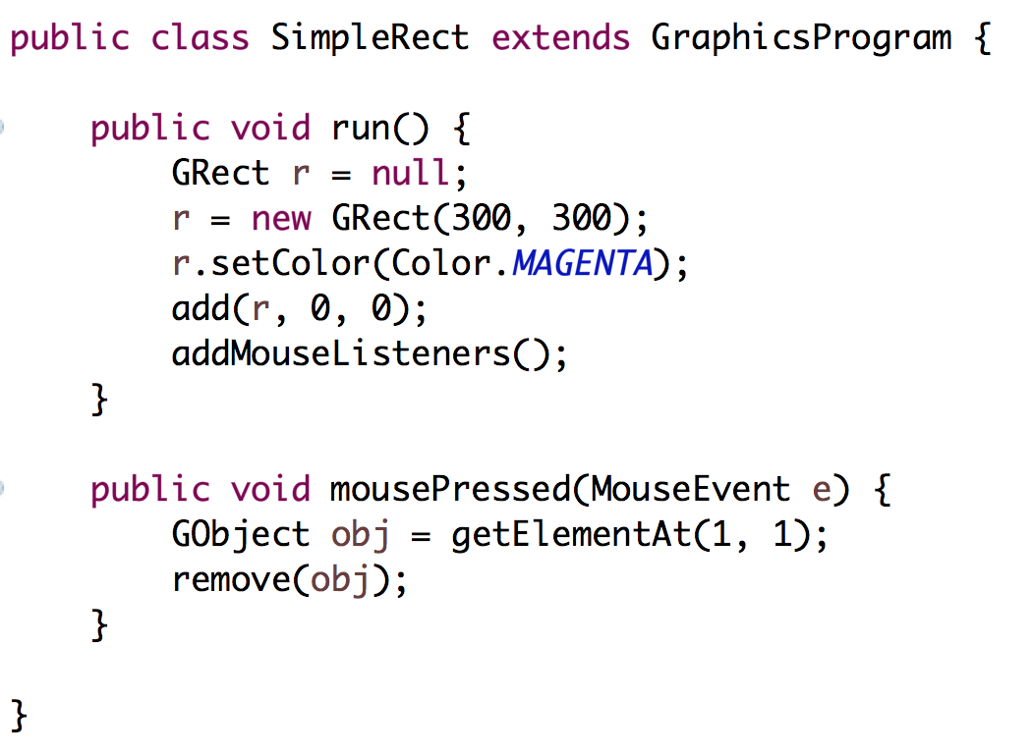
Stack Diagrams
public void run() {
println(toInches(5));
}
private int toInches(int feet){
int result = feet * 12;
return result;
}
run

Slide 8
Stack Diagrams
public void run() {
println(toInches(5));
}
private int toInches(int feet){
int result = feet * 12;
return result;
}
run

Slide 9
Stack Diagrams
public void run() {
println(toInches(5));
}
private int toInches(int feet){
int result = feet * 12;
return result;
}
f
run
toInches
feet
5

Slide 10
Stack Diagrams
public void run() {
println(toInches(5));
}
private int toInches(int feet){
int result = feet * 12;
return result;
}
f
run
toInches
feet
5
result
60

Slide 11
Stack Diagrams
public void run() {
println(toInches(5));
}
private int toInches(int feet){
int result = feet * 12;
return result;
}
f
run
toInches
feet
5
stack
result
60

Slide 12
Stack Diagrams
public void run() {
println(toInches(5));
}
private int toInches(int feet){
int result = feet * 12;
return result;
}
f
run
60

Slide 13
Aside: Actual Memory

Slide 14
What is a bucket
feet
5

Slide 15
What is a bucket
feet
1011100111100011
0011010110010100
* Each bucket or “word” holds 64 bits

Slide 16
#0: don’t think on the binary level (yet)

Slide 17
End aside

Slide 18
Primitives vs Classes
Primitive Variable Types
Class Variable Types
int
double
char
boolean
GRect
GOval
Gline
Color
Class variables (aka objects)
Have upper camel case types
You can call methods on them
Are constructed using new
Are stored in a special way

Slide 19
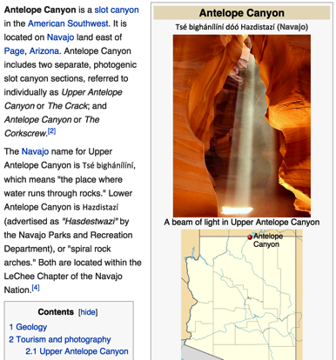
How do you share wikipedia articles?
Antelope Canyon Article
Key:
https://en.wikipedia.org/wiki/Antelope_Canyon

Slide 20
Objects store addresses
(which are like URLs)

Slide 21
What does an object store?

Slide 22
Objects store addresses
(which are like URLs)

Slide 23

By Chris Piech

Slide 24
origin
Nick Troccoli
By Chris Piech

Slide 25
Once upon a time…

Slide 26
…a variable x was born!
int x;

Slide 27
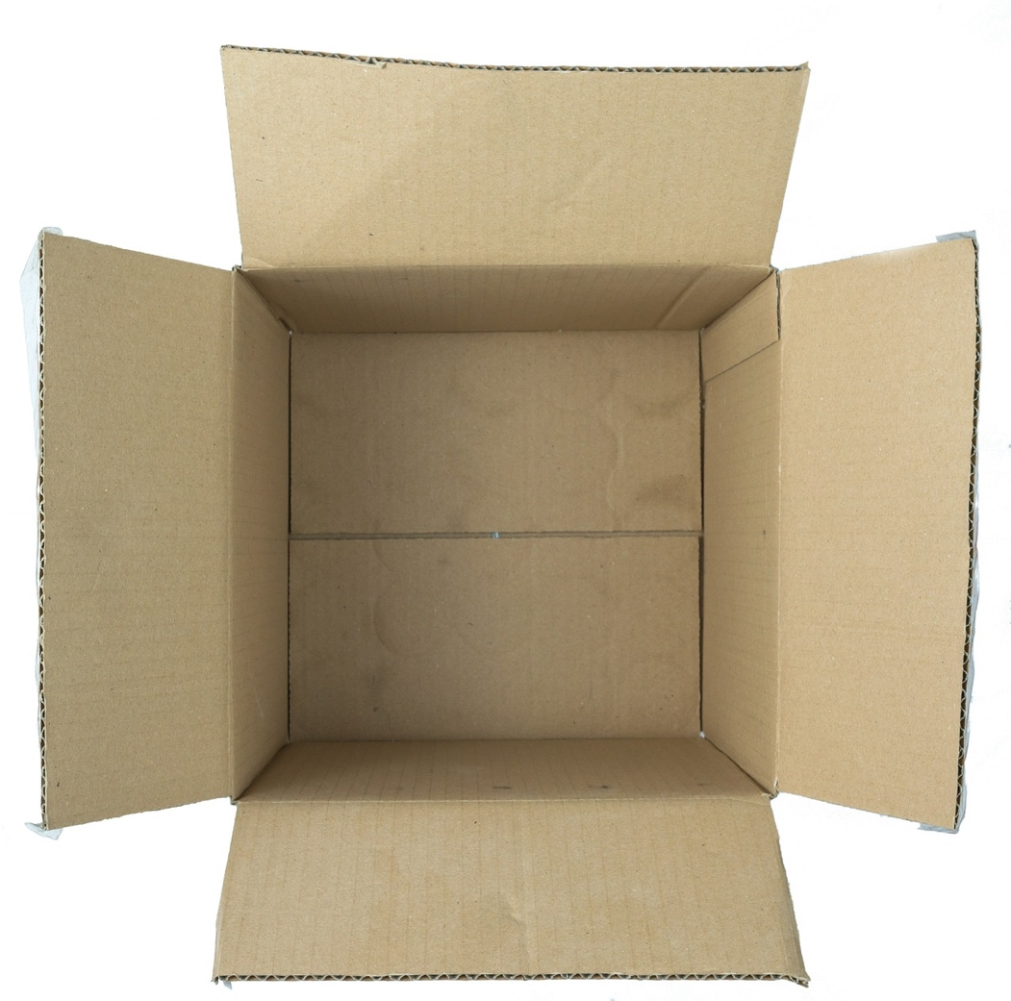
…a variable x was born!
int x;

Slide 28
x was a primitive variable…
int x;
It’s so cuuuute!
Aww…!

Slide 29
…and its parents loved it very much.
int x;
We should give it…. value 27!

Slide 30
…and its parents loved it very much.
x = 27;
We should give it…. value 27!
27

Slide 31
A few years later, the parents decided to have another variable.

Slide 32
…and a variable rect was born!
GRect rect;

Slide 33
rect was an object variable…
GRect rect;
Who’s a cute GRect???
It’s so square!

Slide 34
…and its parents loved it very much.
GRect rect;
We should make it…. a big, strong GRect!

Slide 35
…and its parents loved it very much.
GRect rect = new Grect(0, 0, 50, 50);
We should make it…. a big, strong GRect!

Slide 36
…but rect’s box was not big enough for an object!
GRect rect = new Grect(0, 0, 50, 50);
That box isn’t big enough to store everything about a GRect!

Slide 37


…so they stored the information in a bigger box somewhere else.
GRect rect = new Grect(0, 0, 50, 50);
x = 0, y = 0
width = 50
height = 50
...
Location 5
See location 5
Notes:
Stack and heap

Slide 38
Chapter 2: Coming soon

Slide 39
public void run() {
GRect r = null;
}
Method memory
Object memory

Slide 40
public void run() {
GRect r = null;
}
Method memory
Object memory
run
r
null

Slide 41
Wahoo!

Slide 42
public void run() {
GRect r = new GRect(50, 50);
}
Method memory
Object memory
run
r

Slide 43
public void run() {
GRect r = new GRect(50, 50);
}
Method memory
Object memory
run
memory.com/18
r

Slide 44
public void run() {
GRect r = new GRect(50, 50);
}
Method memory
Object memory
run
memory.com/18
r
memory.com/18

Slide 45
public void run() {
GRect r = new GRect(50, 50);
}
Method memory
Object memory
run
18
r
18

Slide 46
public void run() {
GRect r = new GRect(50, 50);
}
Method memory
Object memory
run
r

Slide 47
public void run() {
GRect r = new GRect(50, 50);
r.setColor(Color.BLUE);
r.setFilled(true);
}
Method memory
Object memory
run
r

Slide 48
public void run() {
GRect r = new GRect(50, 50);
r.setColor(Color.BLUE);
r.setFilled(true);
}
Method memory
Object memory
run
r

Slide 49
public void run() {
GRect r = new GRect(50, 50);
r.setColor(Color.BLUE);
r.setFilled(true);
}
Method memory
Object memory
run
r

Slide 50
#1: new allocates memory for objects
* The data for an object can’t always fit inside a fixed size bucket

Slide 51
#2: object variables store addresses
#ultimatekey

Slide 53
What does an object store?

Slide 54
Objects store addresses
(which are like URLs)

Slide 60

Memory
Object Memory
Instance Variables
www.memory.com/12
canvas
memory.com/12
run
r
www.memory.com/12

Slide 61
Memory
Object Memory
Instance Variables
www.memory.com/12
canvas
memory.com/12
run
r
www.memory.com/12

Slide 62
Memory
Object Memory
Instance Variables
12
canvas
12
run
r
12

Slide 66
Memory
Heap
Instance Variables
12
canvas
94
mousePressed
e
94
x = 72
y = 94
time = 192332123
obj
12

Slide 67
What does an object store?

Slide 68
Objects store addresses
(which are like URLs)

Slide 69
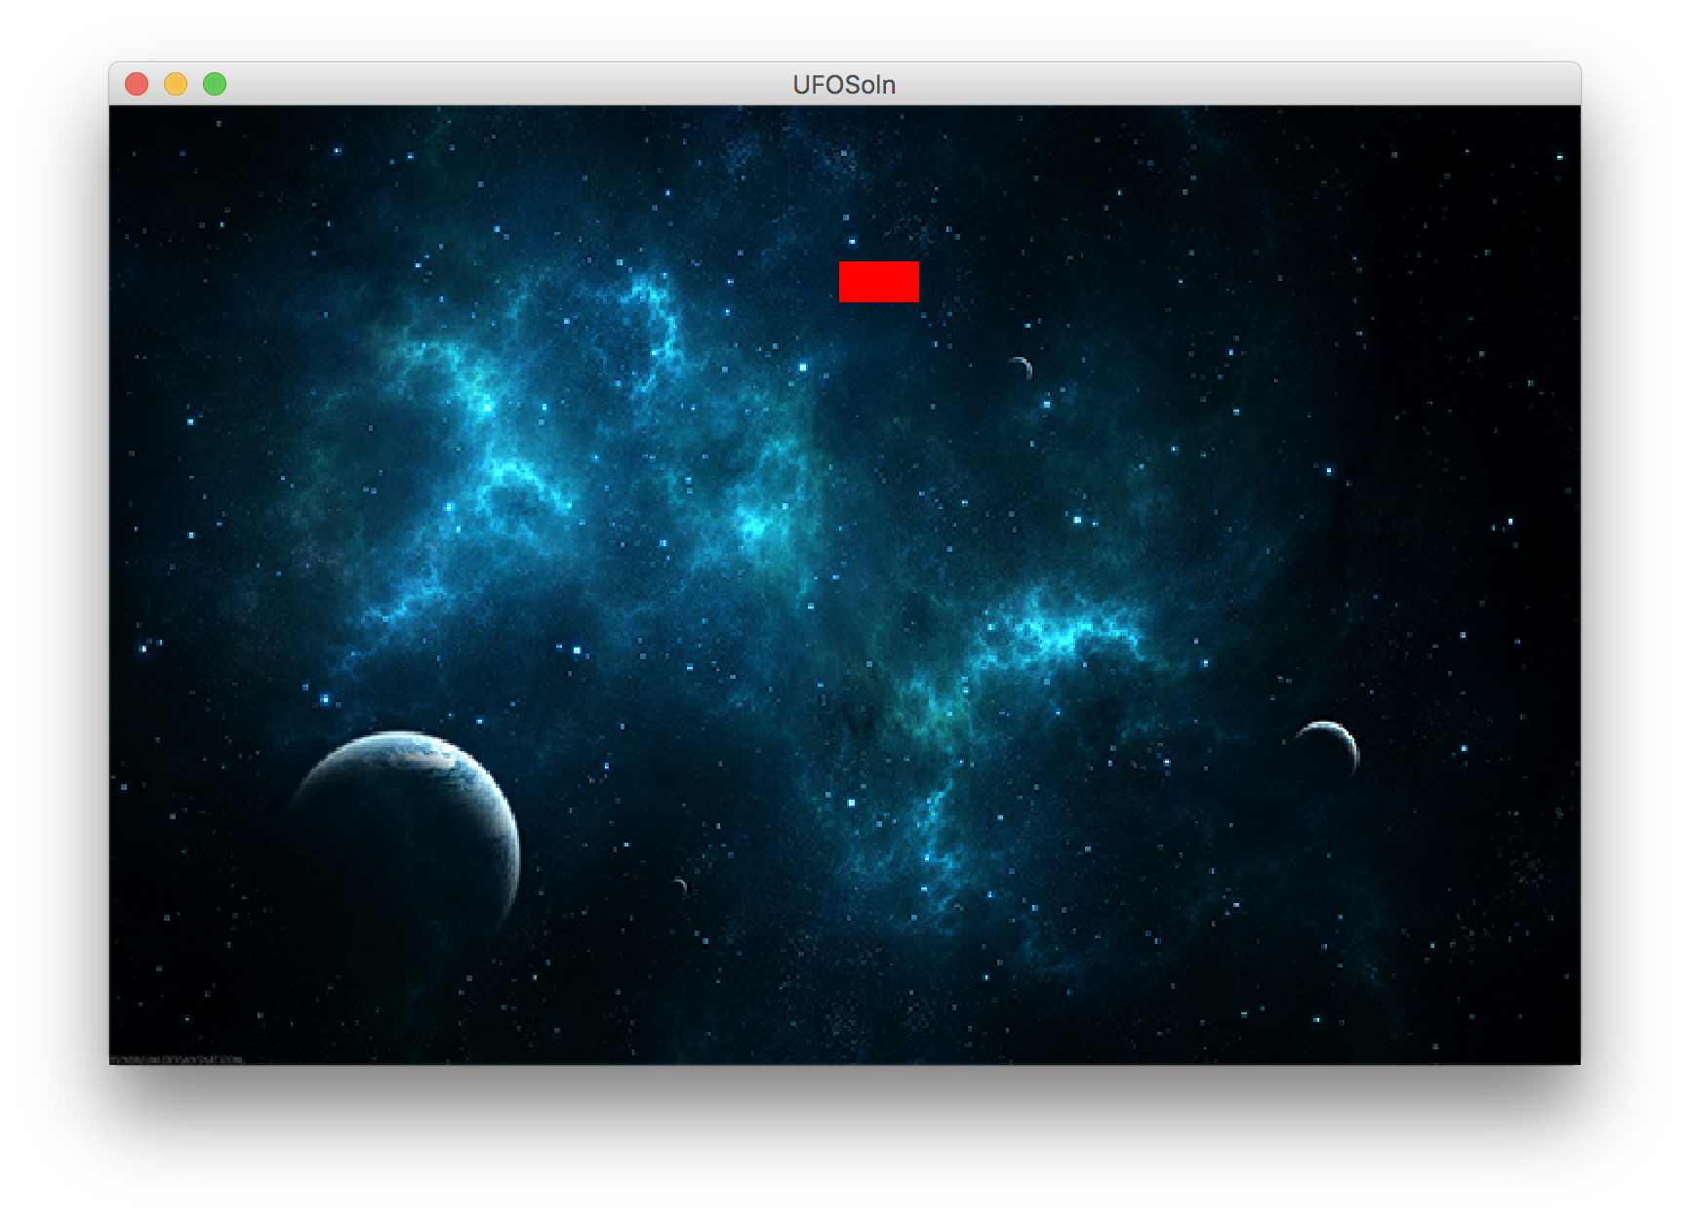
Finish Up

Slide 70
Learning Goals
Be able to write a large program
Be able to trace memory with references

